Slide 1

EW1 : Final eval Smart street lights moksha Choksi – 2024102048 dhanika kothari – 2024102011 team id 29
TA : ANANYA VARMA

Slide 2
BACKGROUND
1. Energy Conservation:
Traditional streetlights consume a lot of energy as they remain fully lit even when there is no activity on the road . Smart street lights dim when no objects are detected, significantly reducing unnecessary energy consumption.
2. Safety and Visibility
Gradual brightness increase ensures better visibility for pedestrians and vehicles when movement is detected . Helps in reducing accidents, especially in poorly lit areas or during the night.
3. Environmental Awareness
Monitoring humidity and temperature raises awareness about local environmental conditions . Encourages eco-friendly initiatives by showing real-time data.
4. Urban Traffic Management
Velocity detection helps in monitoring traffic flow . This data can be used to optimize traffic management and plan road safety measures.

Slide 3
5. Smart Cities Development
Fits into the vision of a modern smart city where resources are used efficiently . Integrates technology to improve urban living standards and infrastructure.
6. Cost Efficiency
Reduced energy consumption leads to lower electricity bills for municipalities . Long-term savings make it a cost-effective solution.
7. Environmental Impact
Promotes sustainable development.
8. Practical Use Cases
Highways and Roads: Helps drivers detect hazards by lighting up only where movement occurs .
Parks and Public Spaces: Offers safe pathways while minimizing light pollution.

Slide 4
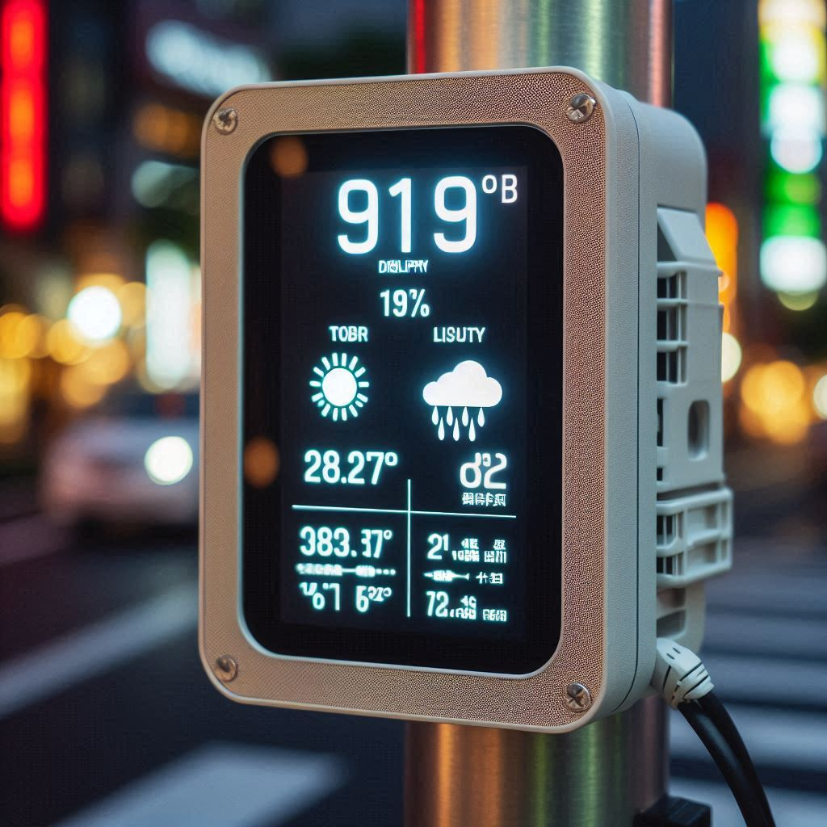
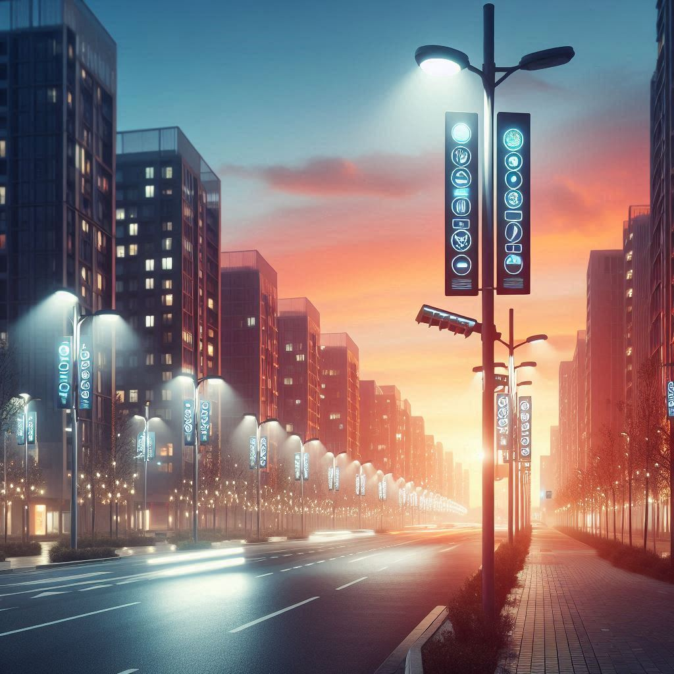
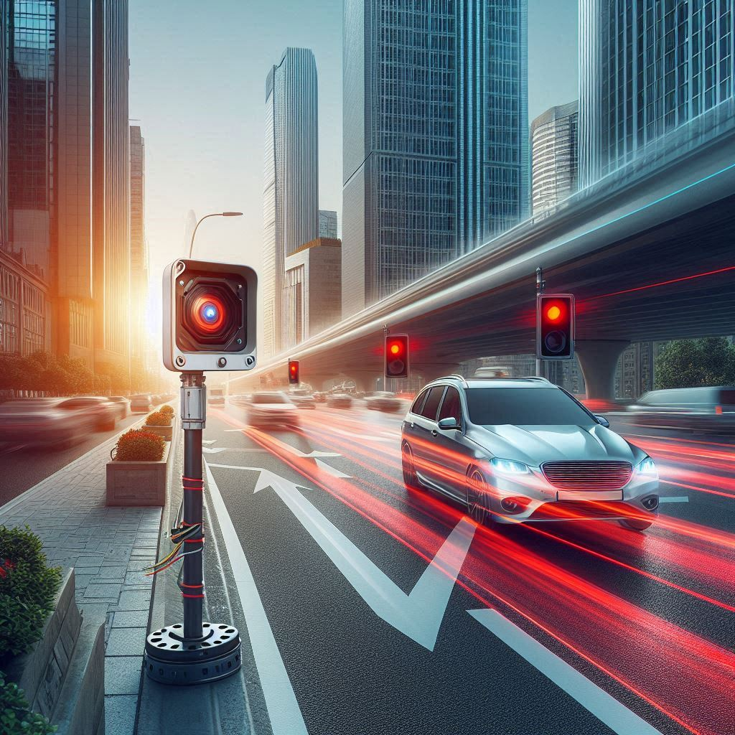
Velocity Detection
Real time Temp and Humidity display
Auto sensing of dawn

Slide 5
Problem Statement
High Energy Consumption
Conventional streetlights stay fully lit regardless of road activity, leading to significant energy wastage . Inefficient Lighting in Low-Activity Area Roads and pathways with minimal traffic or activity remain unnecessarily illuminated.
Automatic detection of dawn by sensors prevents energy wastage due to the carelessness of leaving lights on during the day.
Traditional streetlights do not adjust brightness based on the time of day or ambient light levels, leading to inefficiency.
Safety Concerns
Lack of adaptive lighting can reduce visibility and increase the risk of accidents.
Environmental Impact
Continuous energy consumption contributes to higher carbon emissions and environmental degradation.
Lack of Real-Time Data
Absence of systems to monitor : Traffic flow or object velocity .
Environmental parameters like air quality and temperature.

Slide 6
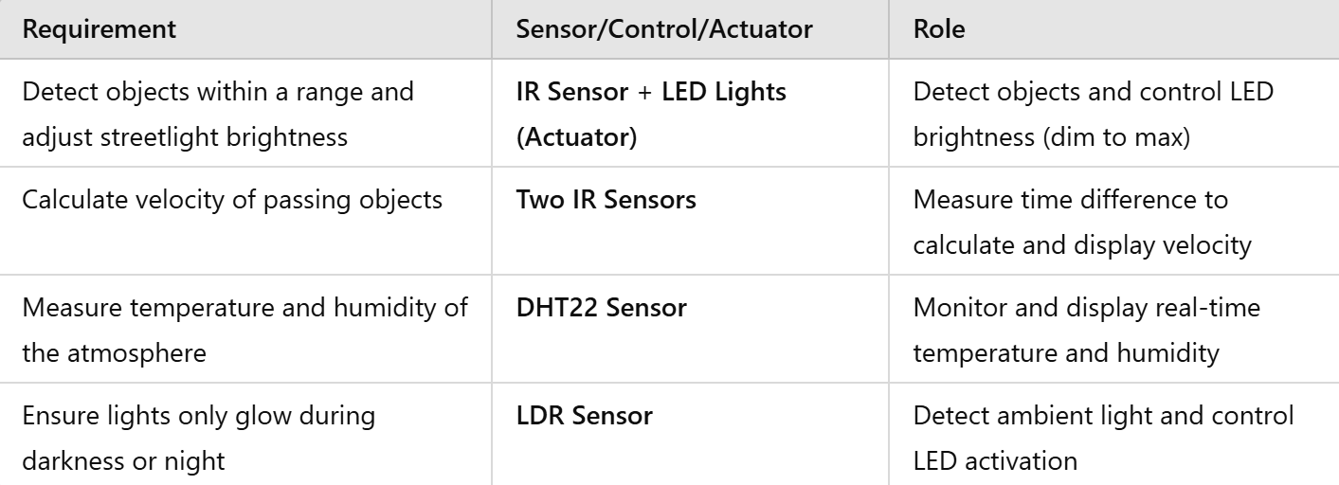
PROPOSED DESIGN

Slide 7
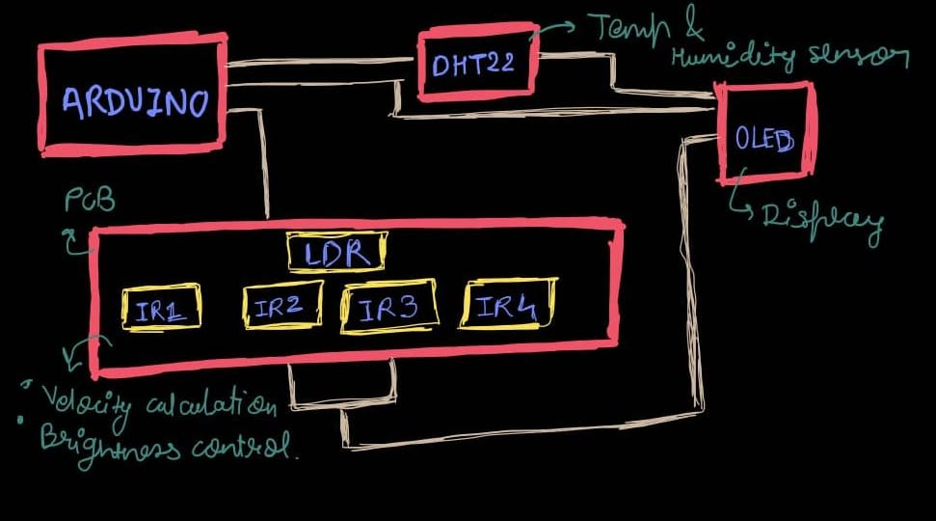
BLOCK DIAGRAM

Slide 8
DESIGN EXPLAINATION
1. IR Sensor for Object Detection:
IR sensors detect objects within a predefined range (threshold set for accurate detection).
When an object is detected, the streetlight switches from dim mode to maximum brightness.
When the object leaves the range, the light dims back, saving energy.
2. Velocity Detection:
Two IR sensors placed at a fixed distance detect when an object passes each sensor.
The time difference between the sensors is used to calculate velocity (velocity = distance/time) and is displayed on an OLED screen.
3. Environmental Data Monitoring:
A DHT22 sensor measures temperature and humidity.
Real-time values are displayed on an OLED display for awareness.
4. Ambient Light Control:
A Light Dependent Resistor (LDR) monitors ambient light levels.
Lights are activated only when ambient light falls below a set threshold (e.g., at night or in dark conditions).
5. Energy Efficiency Focus:
By integrating sensors and actuators, energy is conserved through adaptive brightness and automatic light control.

Slide 9
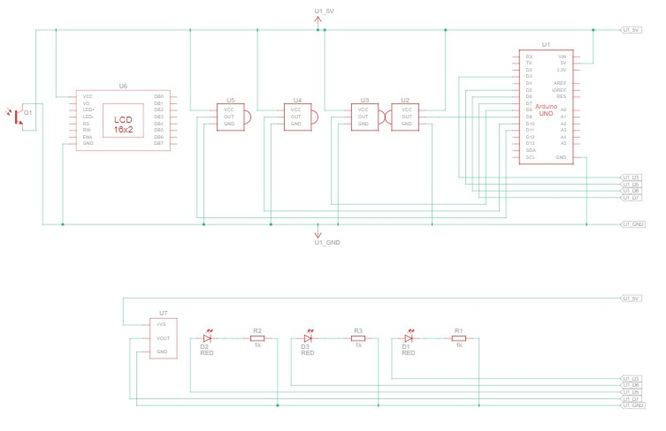
CIRCUIT DIAGRAM

Slide 10
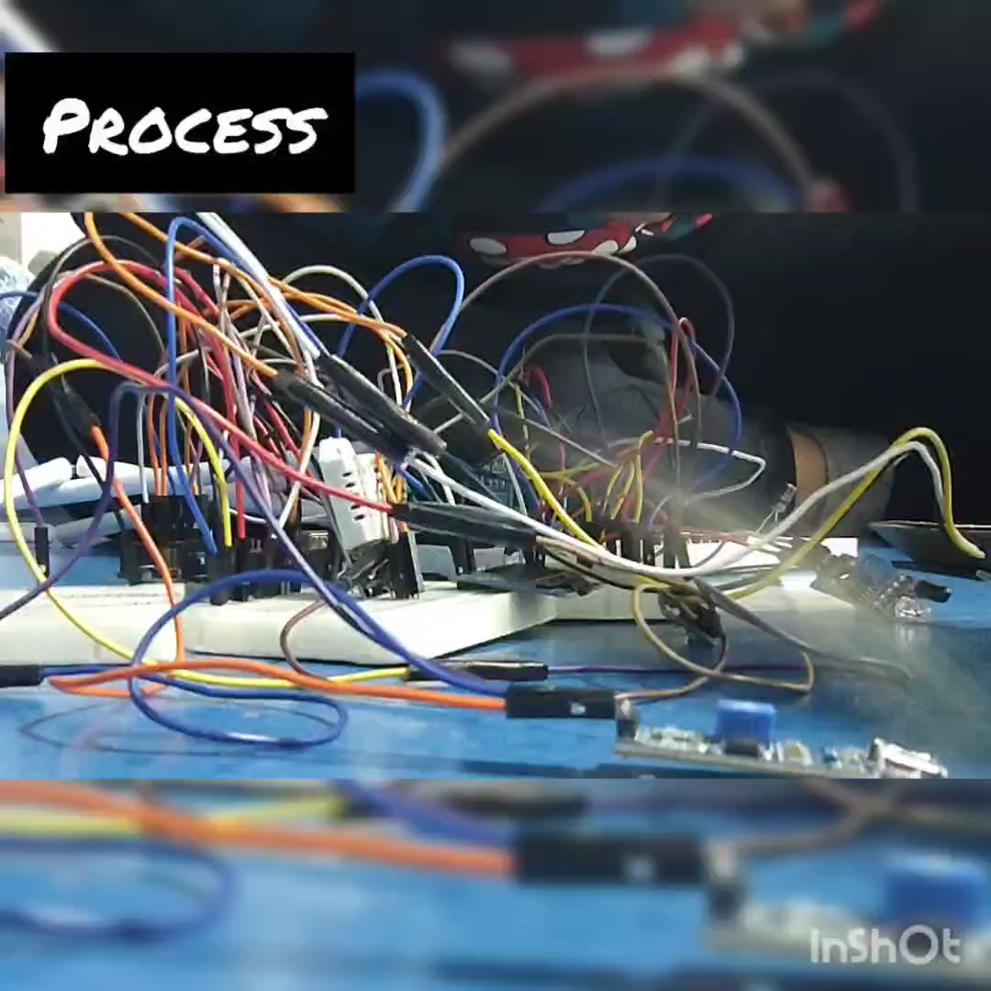

Slide 11
KEY PERFORMANCE INDICATOR
1. Energy Efficiency
Reduction in energy consumption by comparing power usage with conventional streetlights.
Dim-to-bright transitions in minimizing energy wastage.
2. . Light sensitivity and Automation
As soon as the object is detected in the range of IR sensor immediately the lights start turning from dim to bright.
3. Environmental Data Monitoring
Gives real time data of environmental condition which helps in various ways.
4. Cost Efficient
On calculating the total cost it is way far better than traditional solution is an added advantage.

Slide 12
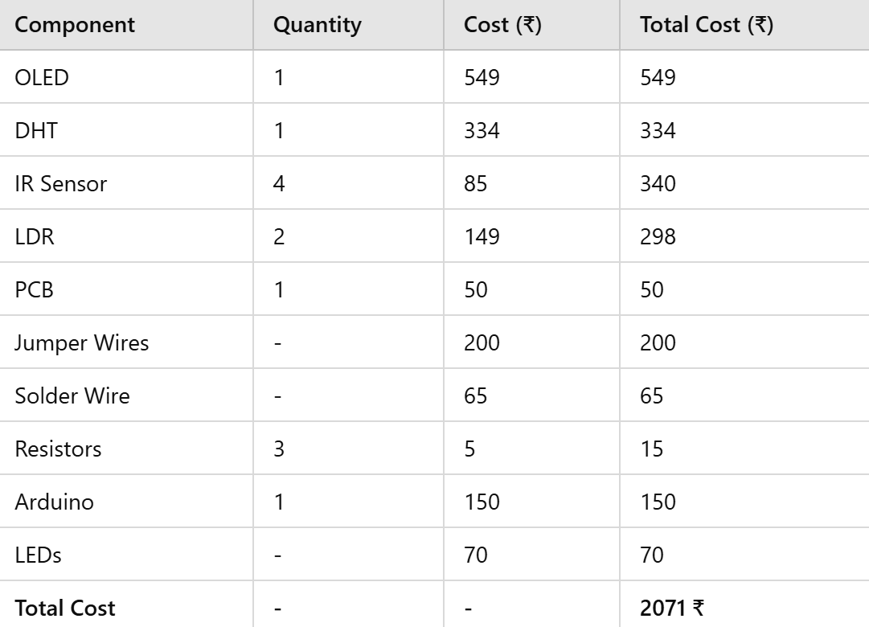
COST OF THE SOLUTION

Slide 13
CONTRIBUTION OF TEAM MEMBERS
MOKSHA CHOKSI | DHANIKA KOTHARI
RESEARCH IR SENSOR CODE AND CIRCUIT OLED CODE AND CIRCUIT FINAL CIRCUIT AND CODE REPORT SETUP | RESEARCH LDR CODE AND CIRCUIT DHT22 SENSOR CODE AND CIRCUIT FINAL CIRCUIT AND CODE PPT SETUP

Slide 14
REMARKS
It was exciting and fun to try new things out and think out of the box to search for sustainable ideas
Research done by the team enhanced our knowledge
Made us more comfortable with Arduino and stuff.

Slide 15
LEARNINGS FROM THE PROJECT
Enhanced our collaborative work .
Addressed real – world challenges through creative and sustainable ideas.
Got to know the usecase of diff libraries.
Integrated sensors like IR , LDR , DHT22 with Arduino..
Designing circuit and assembling PCB.
Debugging Hardware and Software issues.

Slide 16
REFERENCES
https://youtu.be/xQfC72VeV7Y?si=dQpDRnbdeWiXfb1G
https://youtu.be/N_sWjcKR1Nw?si=IKpCycVWp4eJ3Gxa
https://youtu.be/7Wyw7jbHURM?si=PgzJga4APjZee8xJ
https://youtu.be/fjVbcaKW2r0?si=HbBlG6mdrG0bgG2w
https://medium.com/@karkhanaclub/interfacing-oled-display-using-arduino-6d3fed2bd648
https://docs.arduino.cc/libraries/adafruit-unified-sensor/
https://electronoobs.com/eng_arduino_Adafruit_Sensor.php
https://youtu.be/xQfC72VeV7Y?si=dQpDRnbdeWiXfb1G
https://youtu.be/7Wyw7jbHURM?si=unxlJZwJVvWTRsoD
https://youtu.be/fjVbcaKW2r0?si=UO1zU-bg-s566O2-

Slide 17
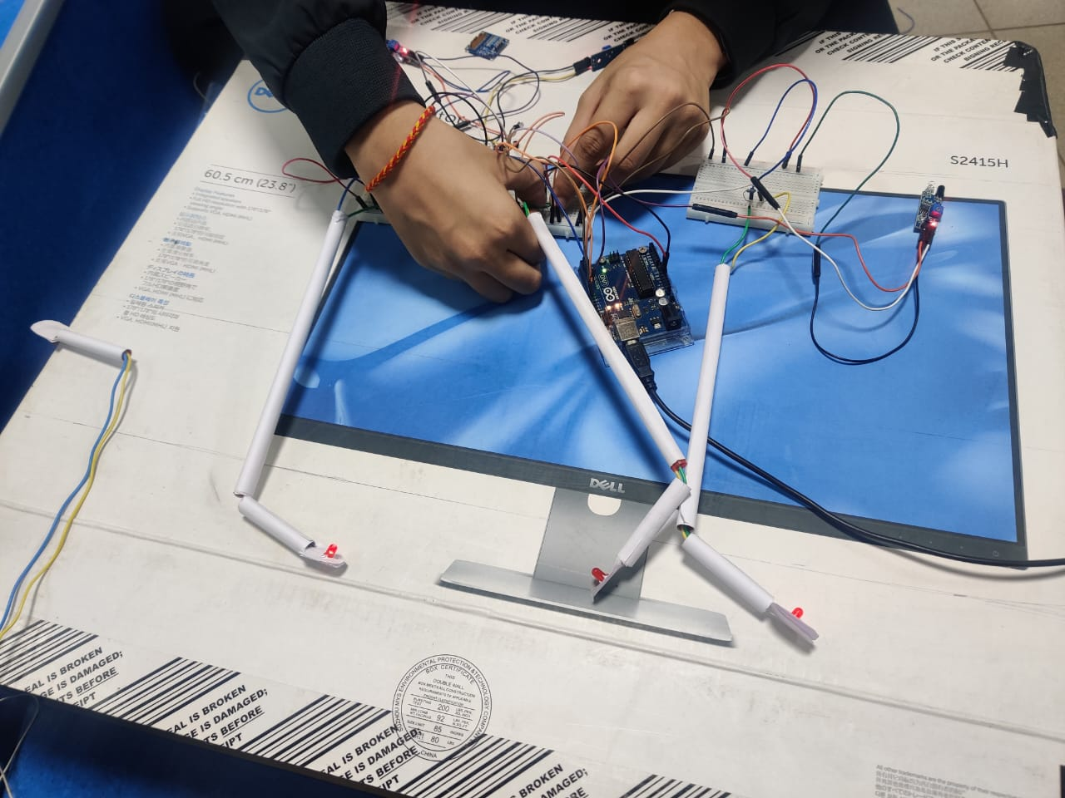
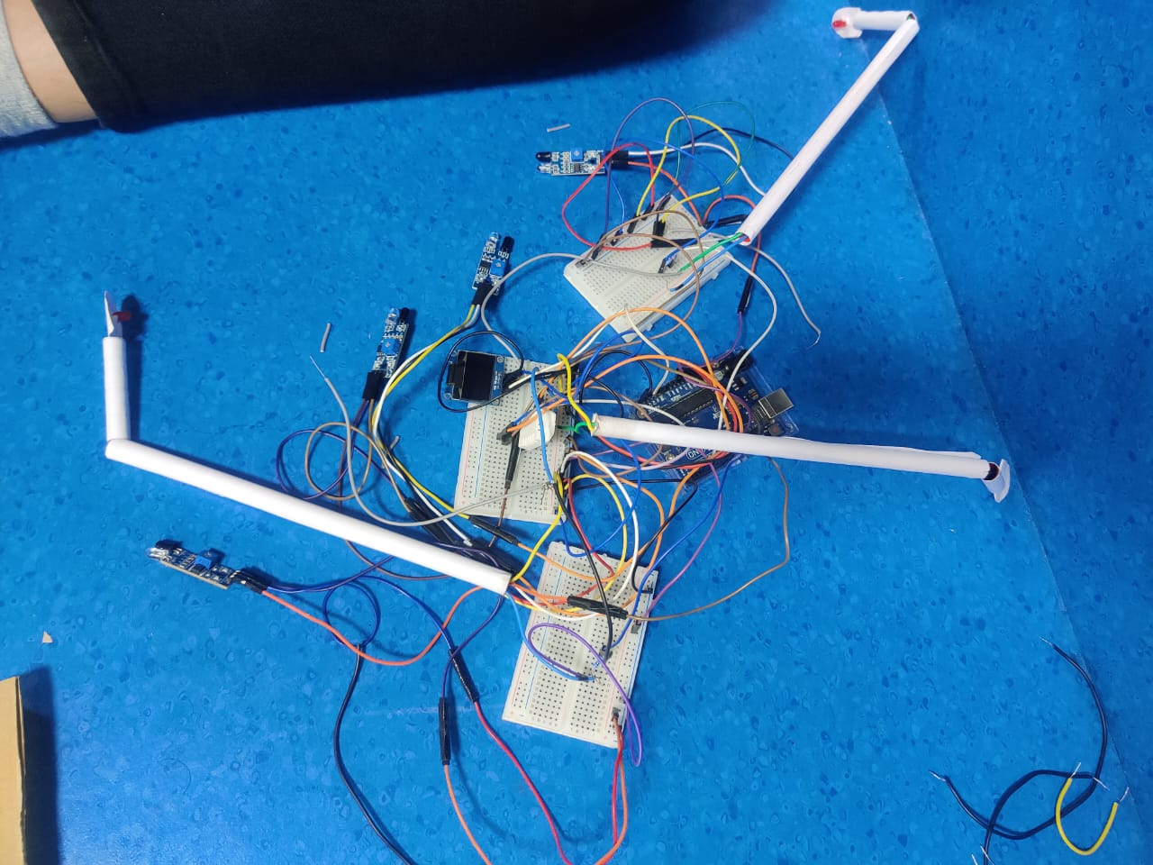
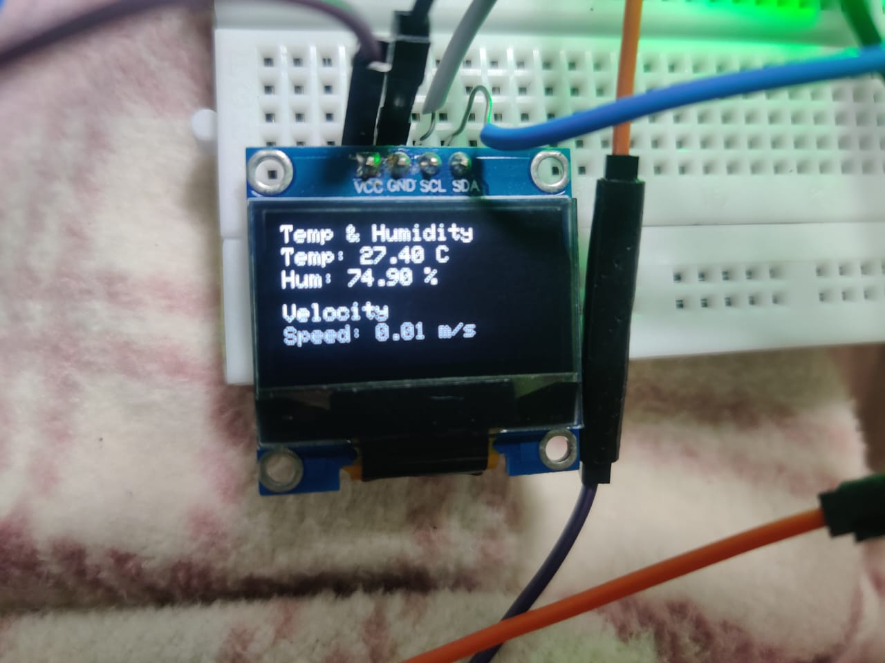
GLIMPSES

Slide 18
THANK YOU!!!

